Slide 1
1756 Alloways Creek Quaker Meetinghouse
Alloways Creek Preparative Meeting
Established 1679

Slide 2
Our goals today
Greenwich/Alloways Creek connection
Photographs of the Alloways Creek Meetinghouse through the years
Preservation plan and path forward
Fundraising plans
Raise visibility of the Alloways Creek meetinghouse in the Quarter
Encourage others to join us

Slide 3
Handouts
List of names associated with Alloways Creek Preparative Meeting through the years
“Crick” Graveyard map and listing
National Register Registration
Uses Workshop report
Notes from the past: Spring 1985
Tri-Fold history brochures

Slide 4
Significant History
1678 First meetings held at the home of John Denn
1679 Alloways Creek Preparative Meeting formed. 3rd Quaker Meeting in West Jersey (after Salem and Burlington)
1684 First Meetinghouse built on north side of Alloways Creek
1717 Second Meetinghouse built on south side of Alloways Creek
1718-1756 South side Meetinghouse in use
1753 William Hancock donates land for present Meetinghouse
1756 current Meetinghouse completed by William Hancock
July 1760 Indenture (deed) from William Hancock to trustees for current Meetinghouse lot
1778 Hancock House massacre of Quaker farmers including William Hancock
1783 Alloway Preparative and Greenwich Preparative Meetings become Greenwich Monthly Meeting
1784 Western part of Alloways Creek meetinghouse built and date stone installed on western end
1820: Ten buttonwood trees planted

Slide 5
The Alloway-Greenwich Connection Source: Salem Quarter History Book
In 1783 Salem Monthly Meeting recommended that “Alloways Creek and Greenwich Preparative meetings be divided off and hold a separate monthly meeting at Friends Meetinghouse in Greenwich until a Meeting House may be built at Alloways Creek to accommodate such Meeting then said monthly meeting to be held alternately.”
Boundaries were established at a monthly meeting held on 29th of Twelfth Month 1783:
All members north and west of Alloways Creek became members of Salem Particular Meeting.
All members south and east of Alloways Creek were to continue as members of Alloways Creek and Greenwich Preparative Meetings respectively, and to become members of the new Greenwich Monthly Meeting.
Notes:
Divided off from Salem Monthly Meeting
Thus the reason why the Alloways Creek meetinghouse expansion was built in 1784.

Slide 6
The following photographs are courtesy of the Friends Historical Library at Swarthmore College and the Salem County Historical Society

Slide 7
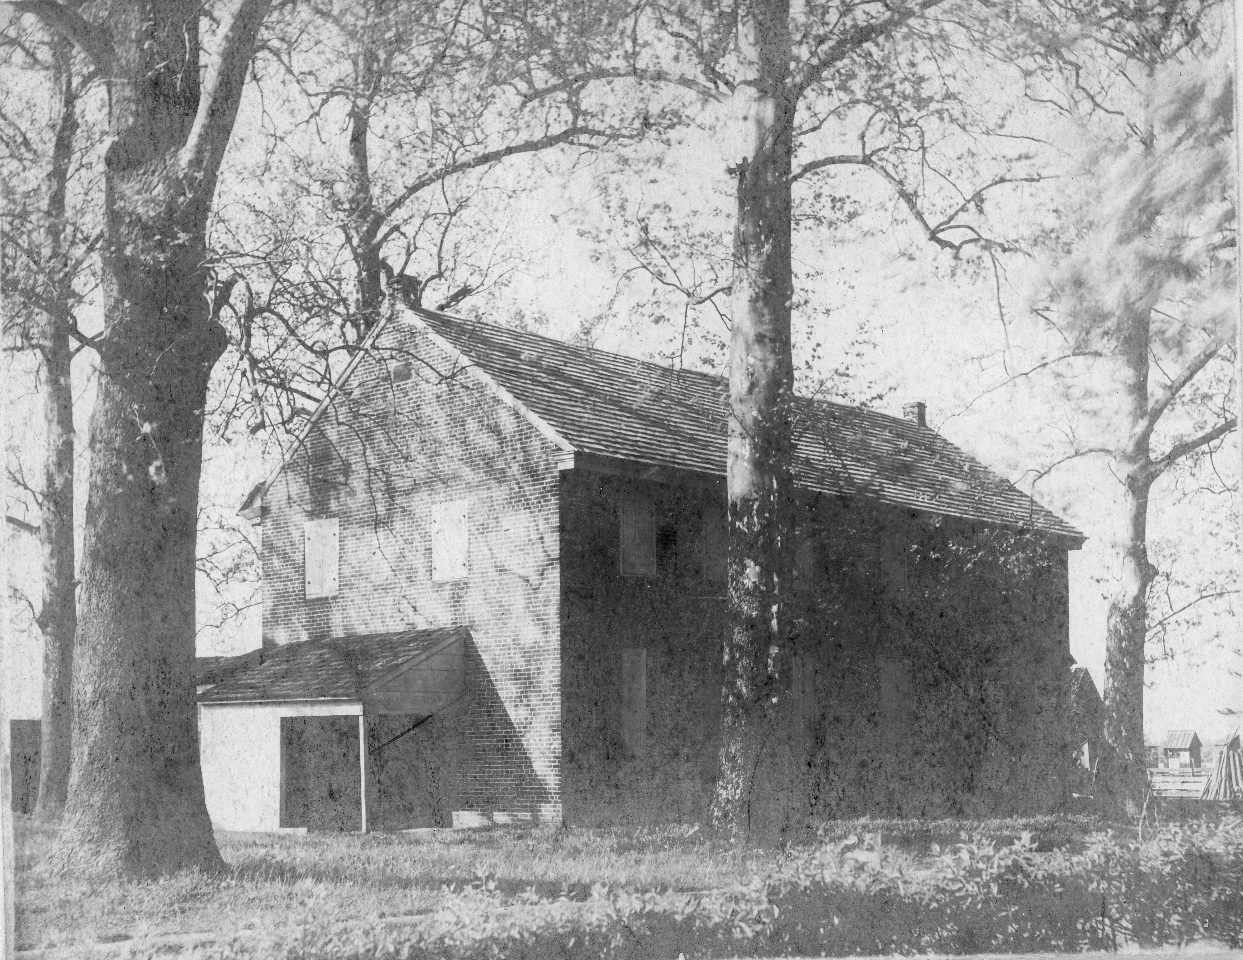
Shelter and privy at west door. Possibly the women’s privy because it is attached to the west (women’s side) door. On the right is believed to be the Buttonwood Academy.
Notes:
We found the footer stone for one of the posts, and the marks and tab on the brick wall where this was attached to the west end wall.

Slide 8
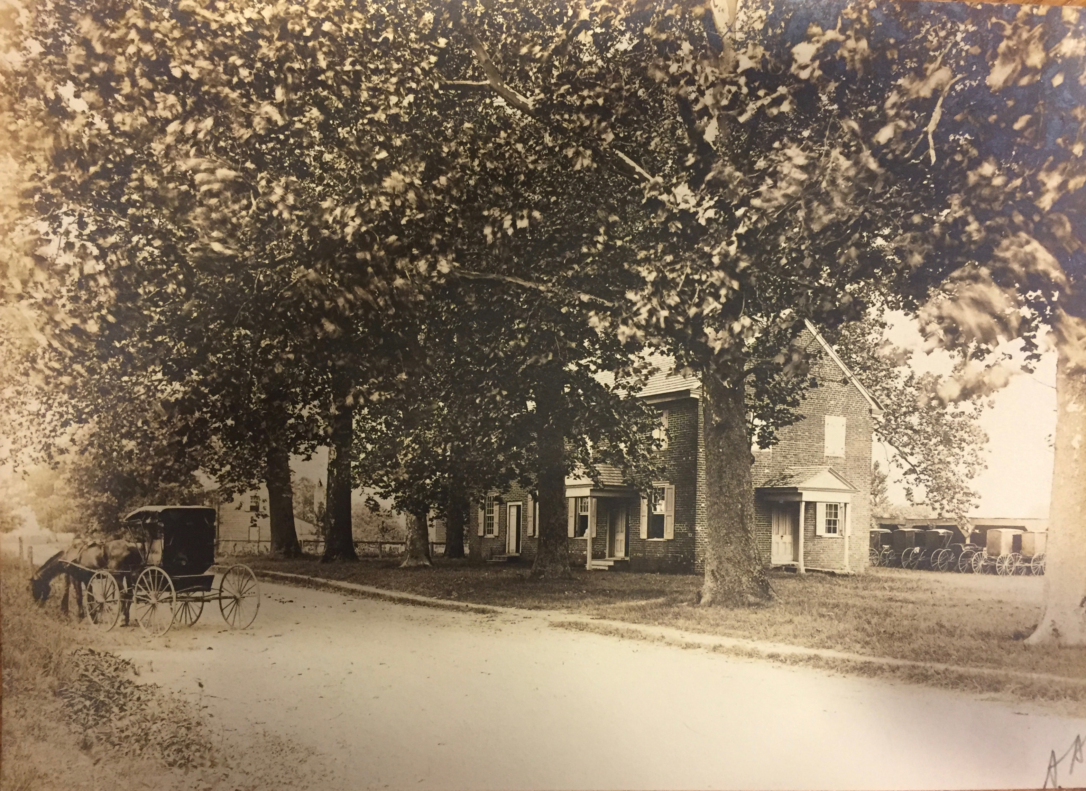
Notes:
Note the horses and buggies in the horse shed, and the absence of the west portico

Slide 9
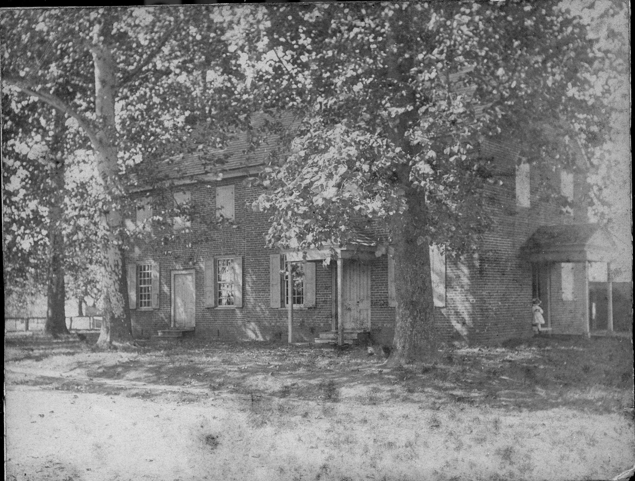
Alloways Creek Meetinghouse, date unknown. Note the absence of the portico over the newer west end door.

Slide 10
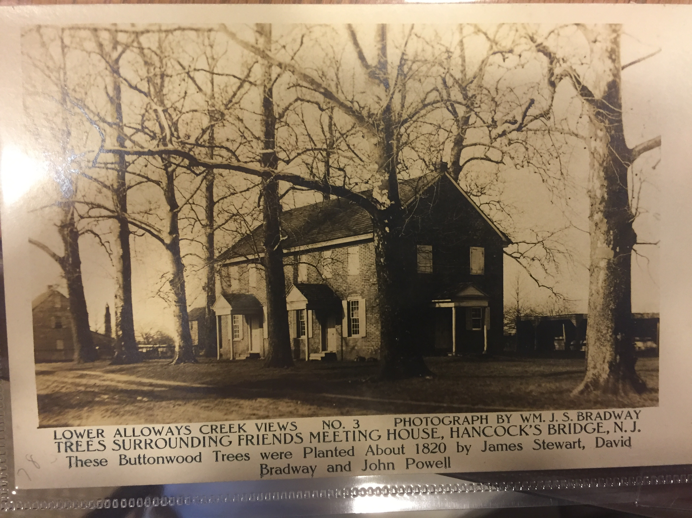

Slide 11
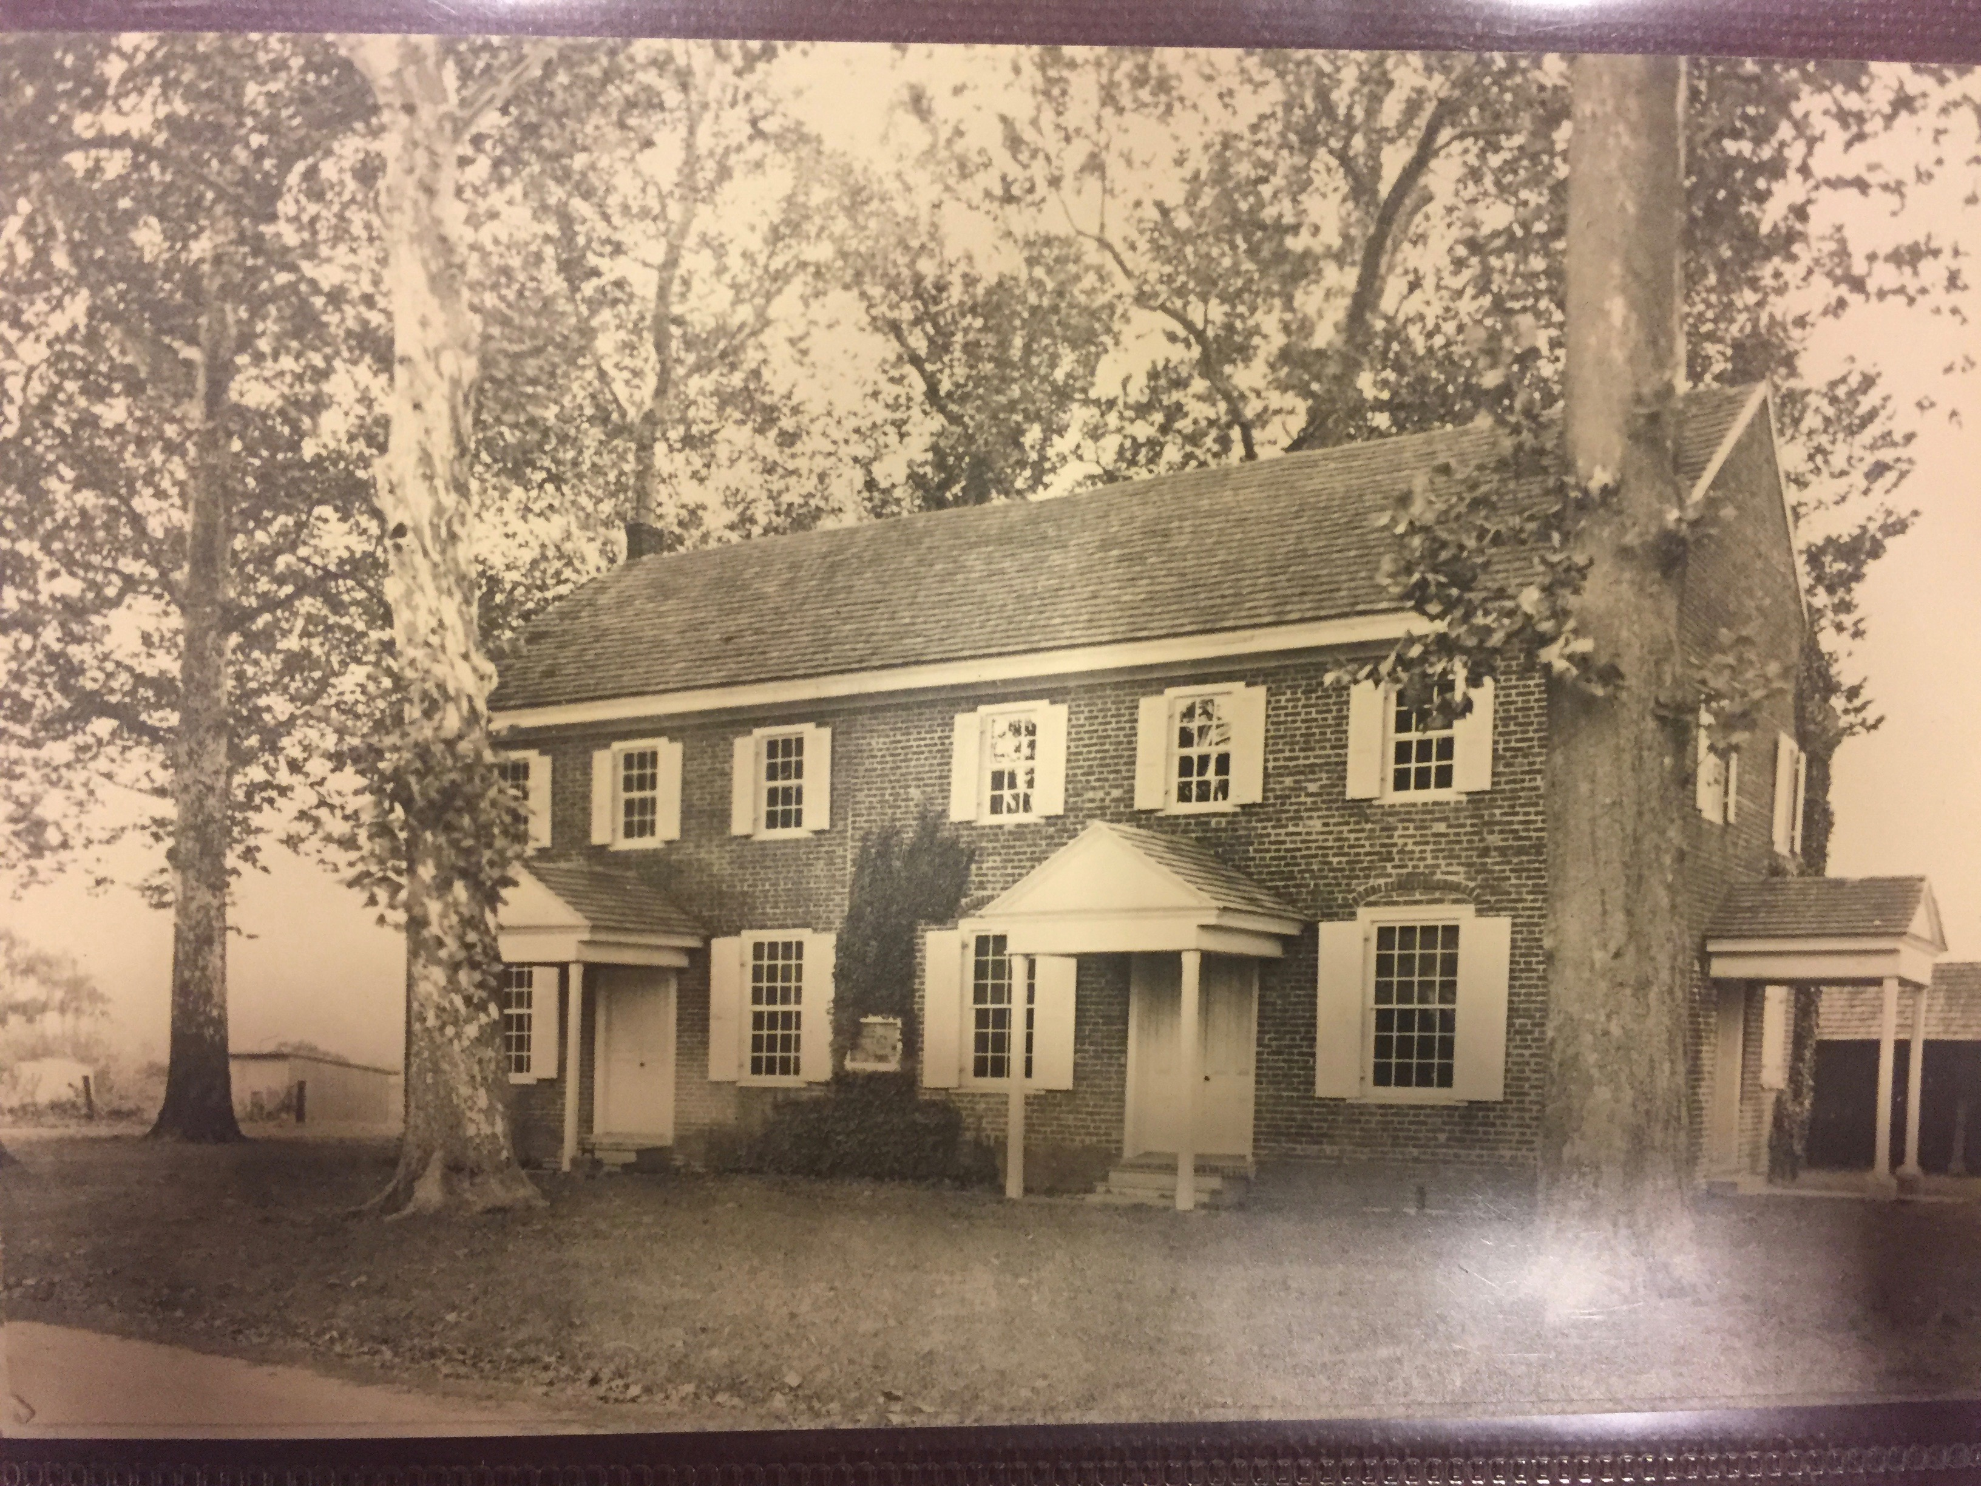
Notes:
Ivy and plaque on front wall

Slide 12
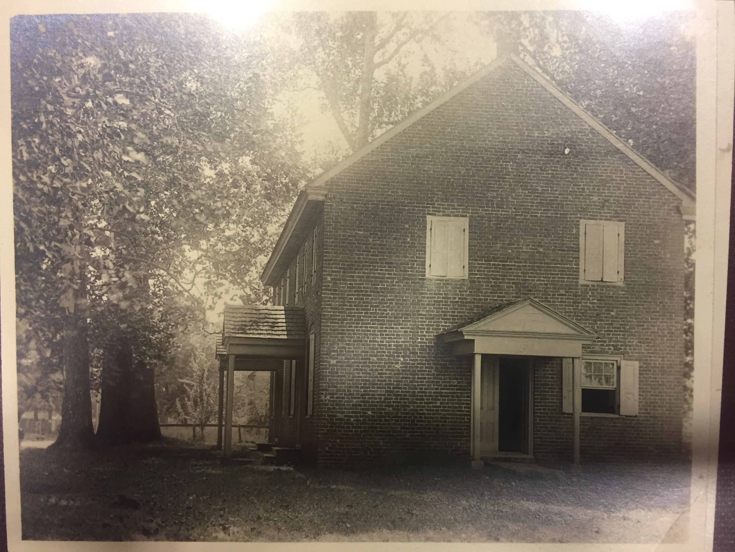

Slide 13
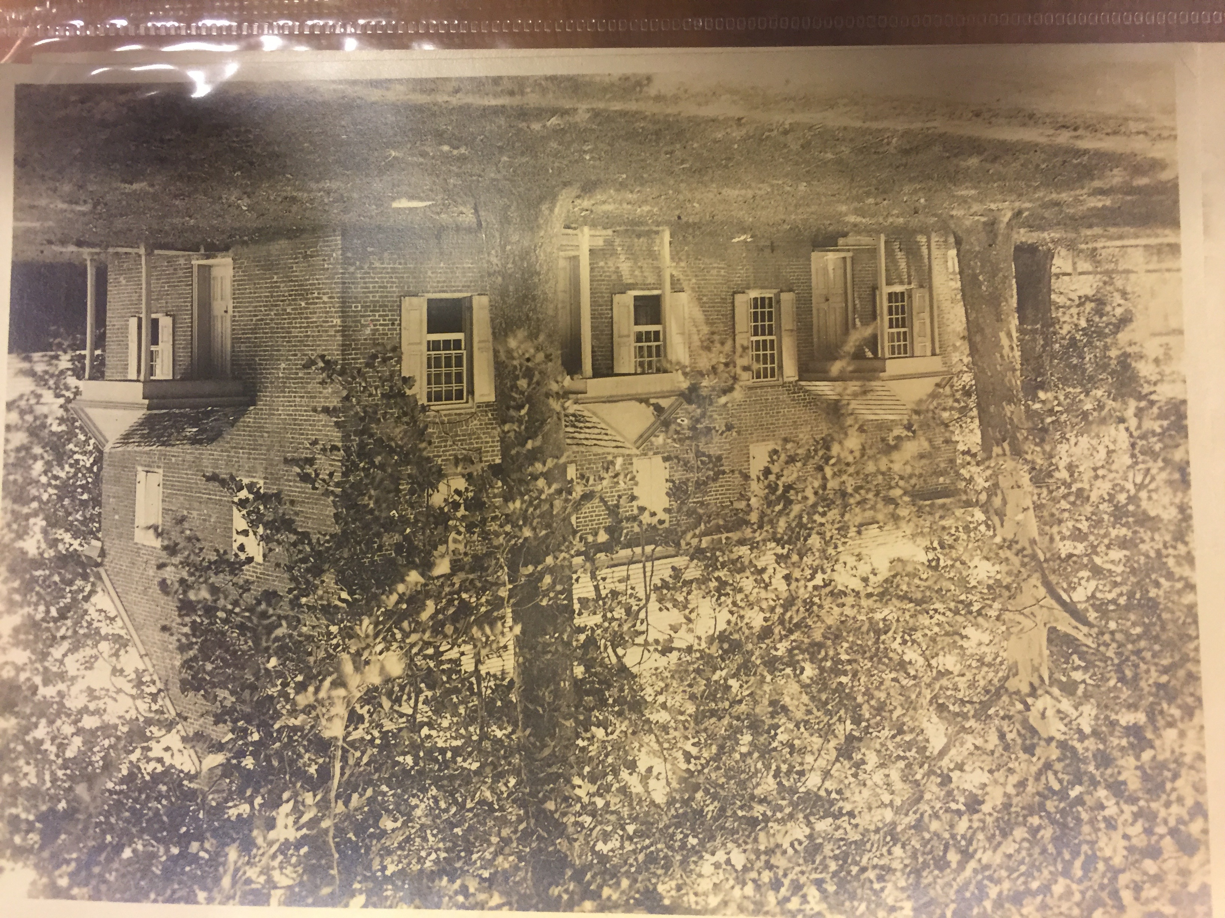
Notes:
Now the plaque is gone

Slide 14
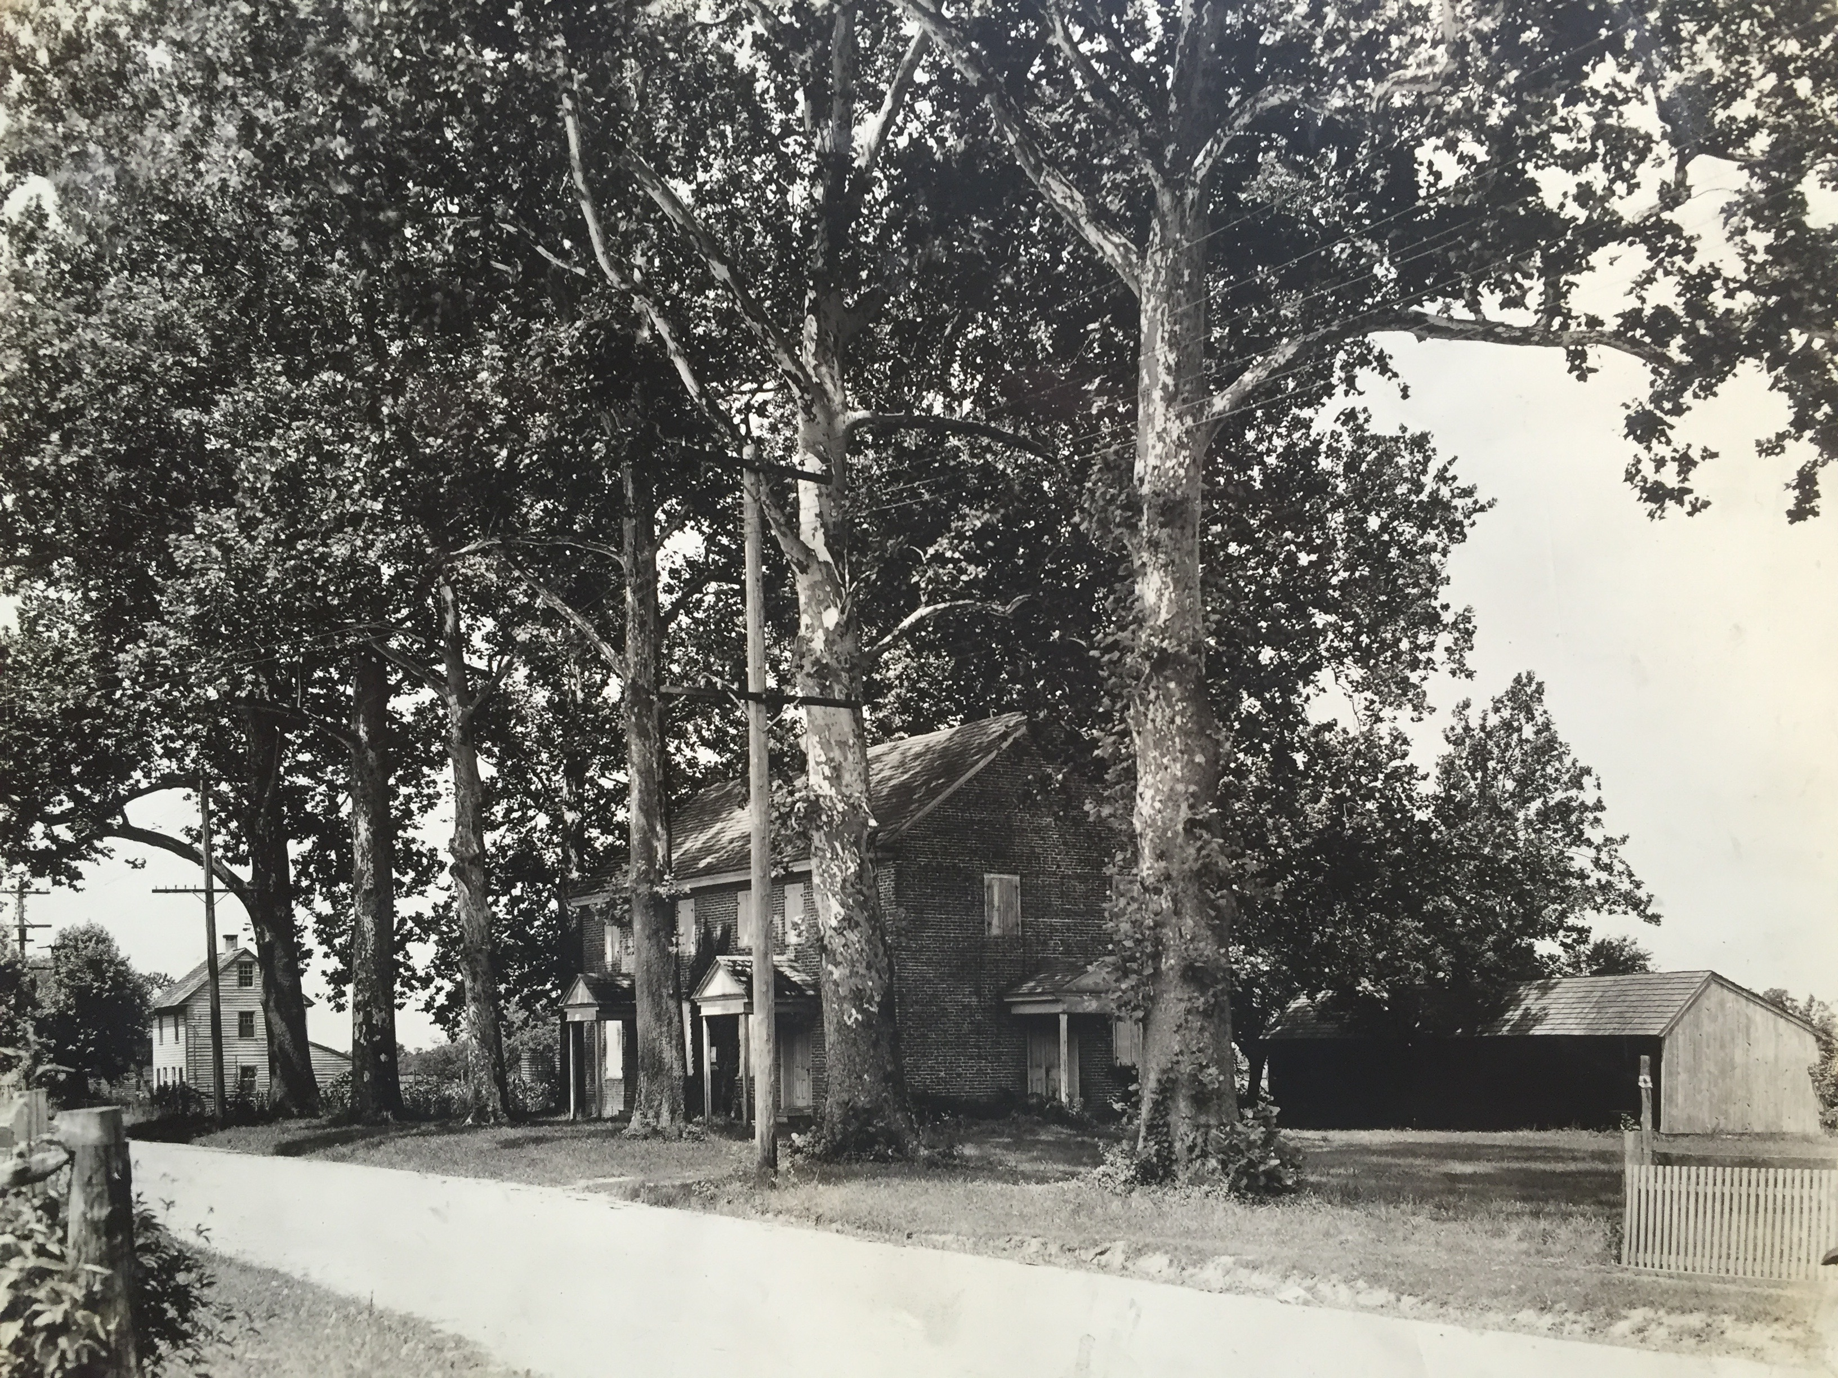
Notes:
Now we have electric in Hancock’s bridge!

Slide 15
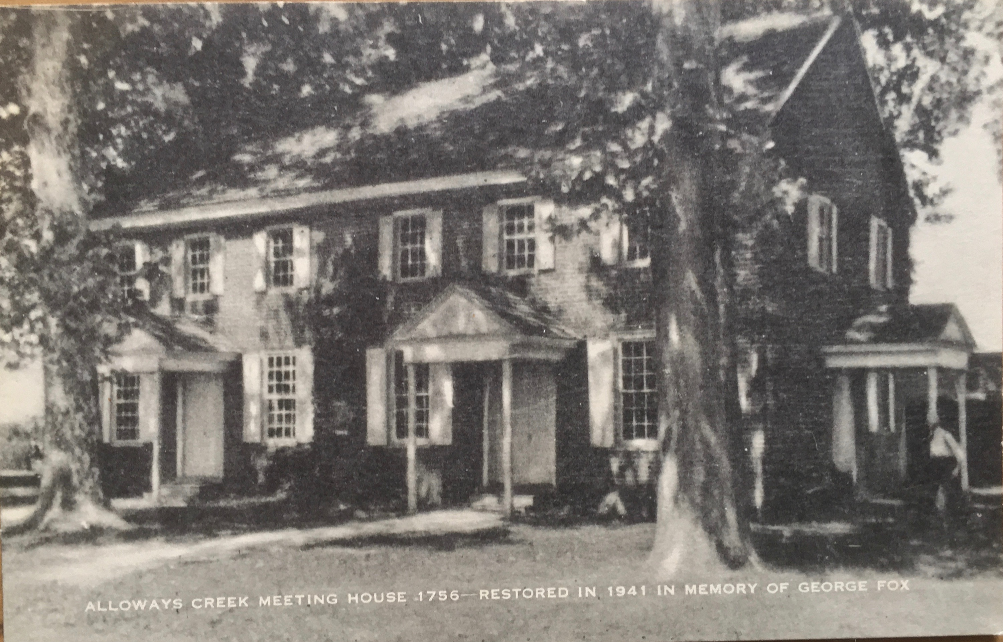
Notes:
Walter Hall (?)
Former clerk of Salem Meeting and Salem Quarterly Meeting, and president of the Salem County Historical Society.

Slide 16
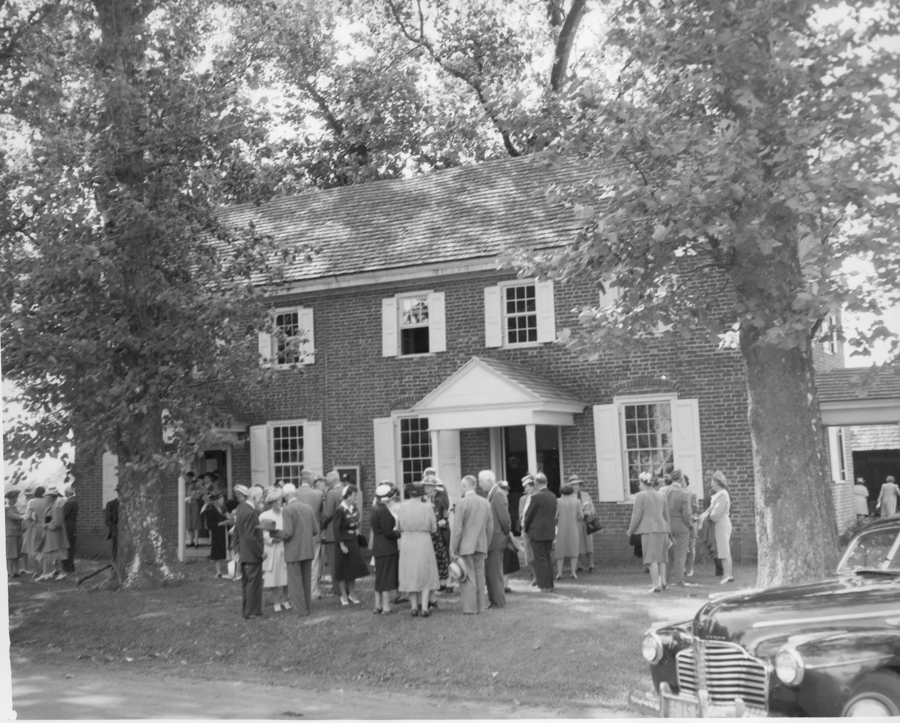
From the Bridgeton Evening News, June 25, 1941
Courtesy of the Salem County Historical Society
Notes:
The plaque is back.

Slide 17
“Part of the audience which had jammed the old Friends Meeting House in Hancock’s Bridge, following the meeting of members and friends of the Cumberland County Historical Society, Salem County Historical Society, and the Cumberland County Friends of the Hancock House, as they stopped to meet and greet friends on the lawn of the building, which has a remarkable appeal to those who acknowledge the debt of the present to the past and recognize the obligation to future generations. The building, in the traditional Friends architecture, is in an excellent state of preservation and the interior has recently been restored under the capable direction of the Salem County Historical Society, of which Walter Hall is the president, and he has been given a large share of the credit. The group lingered here following the meeting and much attention was given to the memorial stones which extend on either side of the path from the entrance toward the road. Mr. Hall explained that when they first became interested in Friends who had been associated with this Friends Meeting years before, they found the modest headstones with the names of the old worthies likely to be lost or forgotten and so they had stones deeply cut with their names and dates and placed them just above the surface of the ground as an enduring memorial. “
From the Bridgeton Evening News, June 25, 1941
Courtesy of the Salem County Historical Society

Slide 18
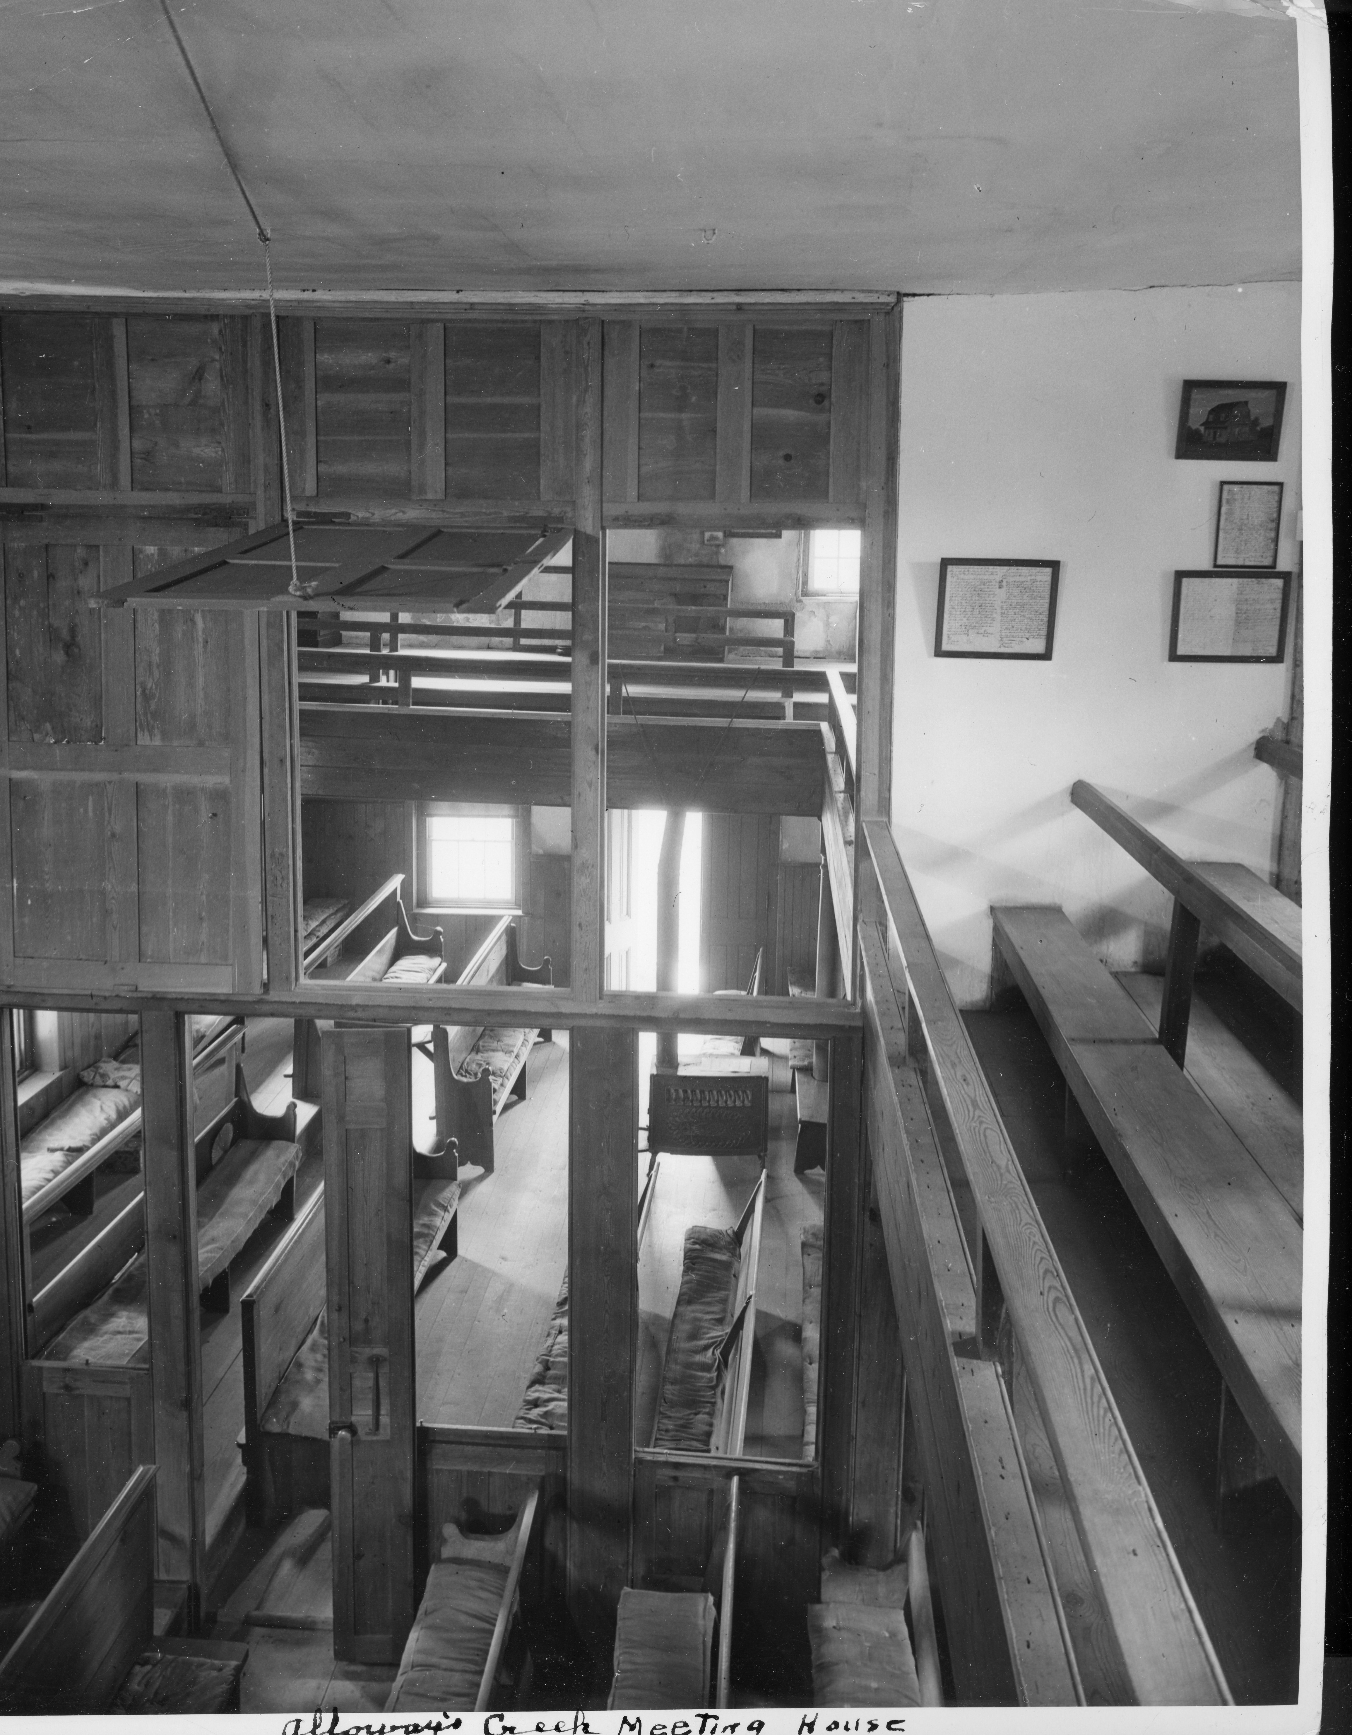
Alloways Creek Meetinghouse Interior, showing items on upstairs wall. Framed documents were moved to Swarthmore Friends Historical Library. The painting is of the Cedar Plank house in Salem: this picture on loan from the Salem County Historical Society Note the old cushions on the benches, and the rope pulley system for opening and closing the upper partitions.

Slide 19
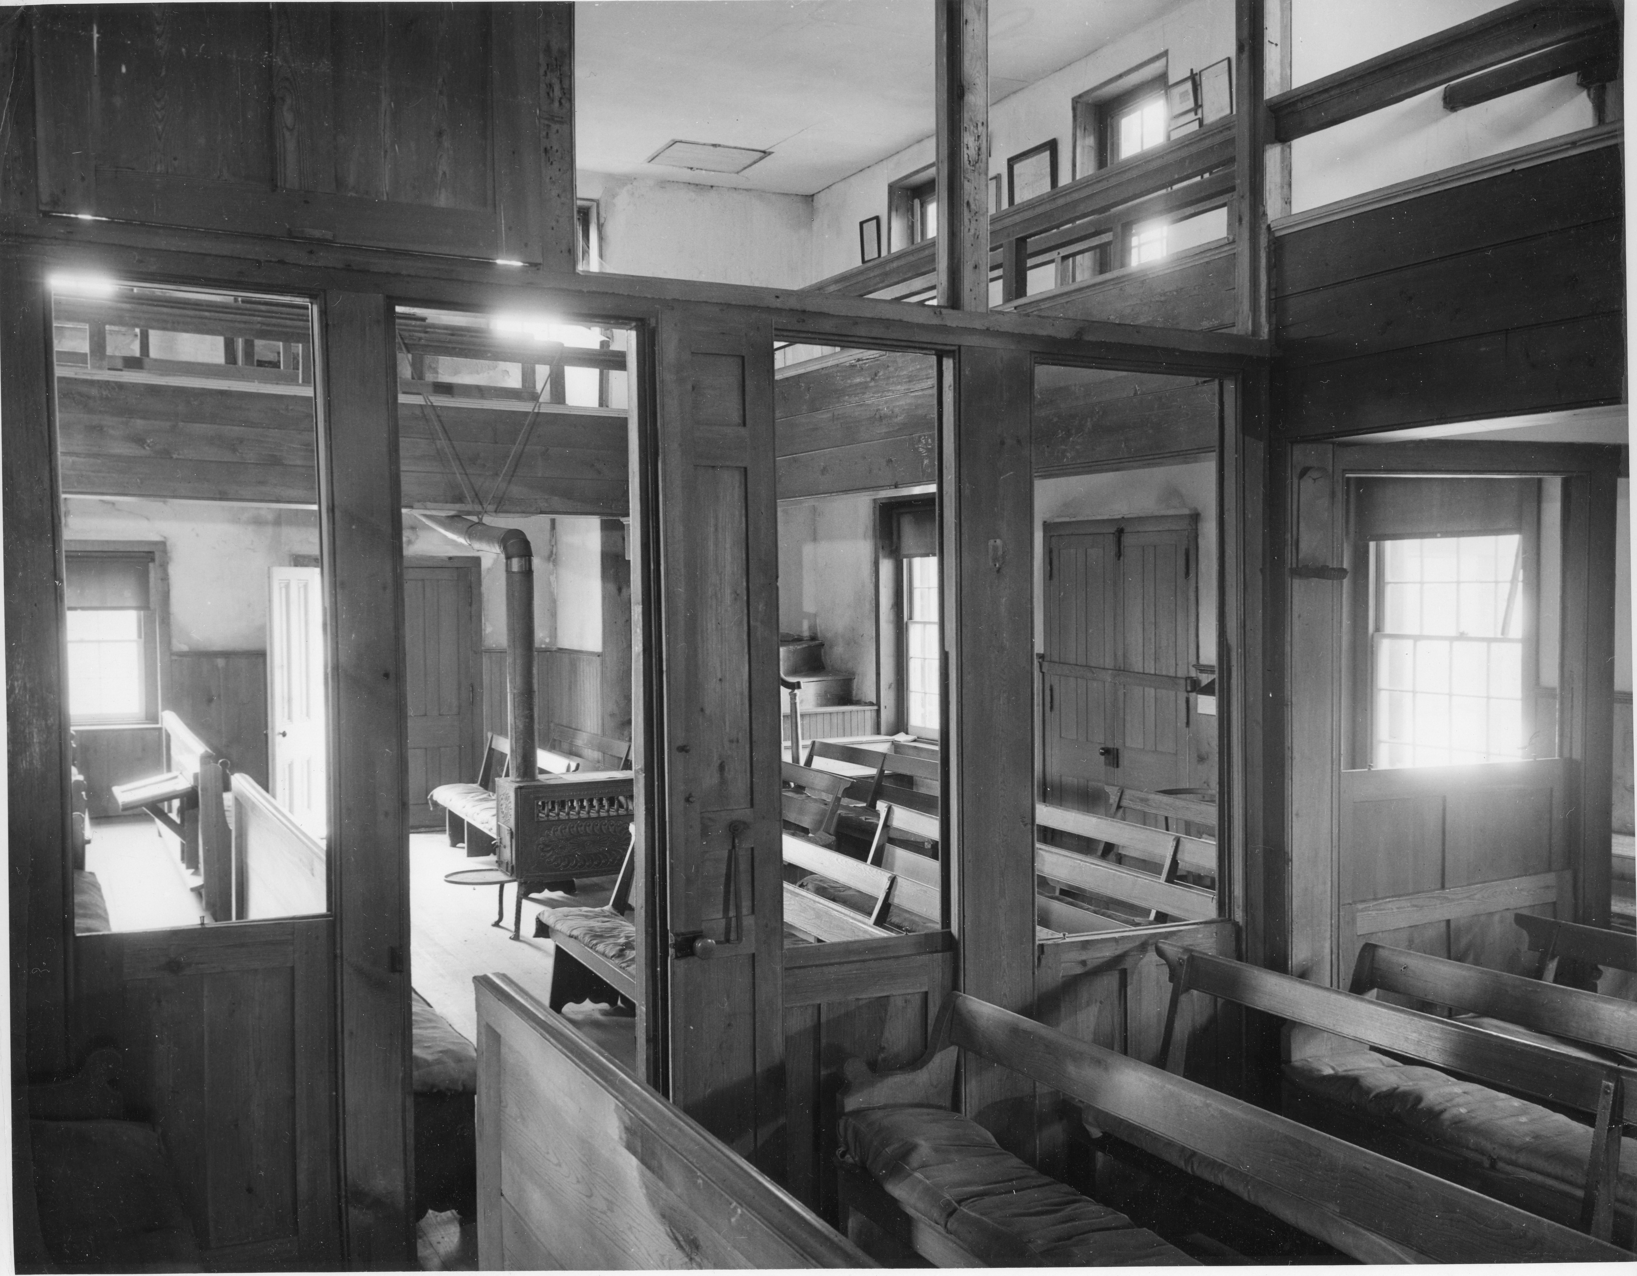
Alloways Creek Meetinghouse Interior, showing items on upstairs wall. Most were moved to Swarthmore Friends Historical Library. Note the old cushions on the benches, and the clerk’s table.

Slide 20
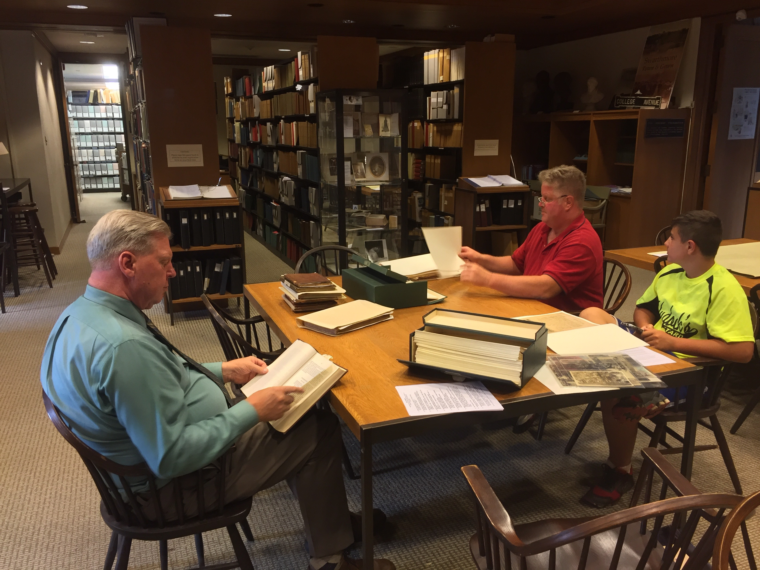
Dave Cadwallader
Various minute books from Alloways Creek Preparative Meeting
Old records from Salem Monthly Meeting
Items from LAC moved to FHS in 1964. Includes detailed inventory by Herb Way
Andrew Cadwallader
Jim Waddington
Mike Ayars (photographer)

Slide 21
Photographs by Mary Waddington

Slide 22
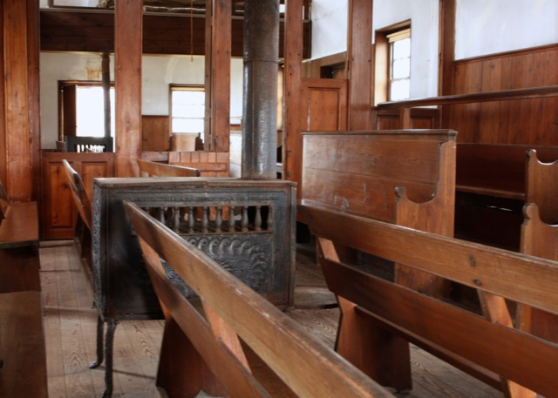

Slide 23
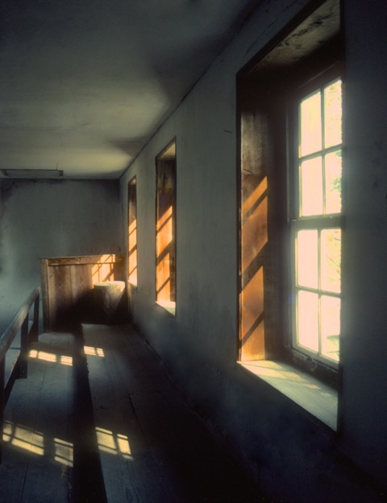

Slide 24
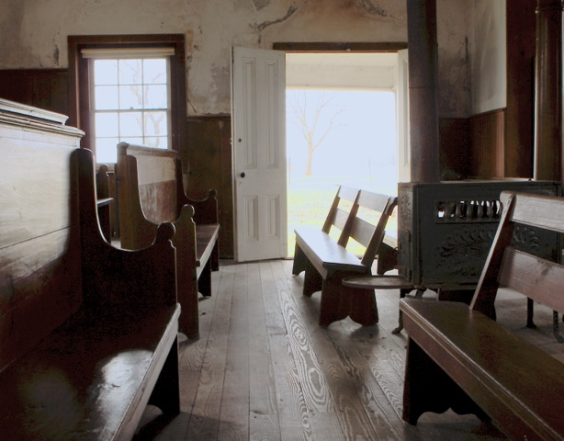

Slide 25
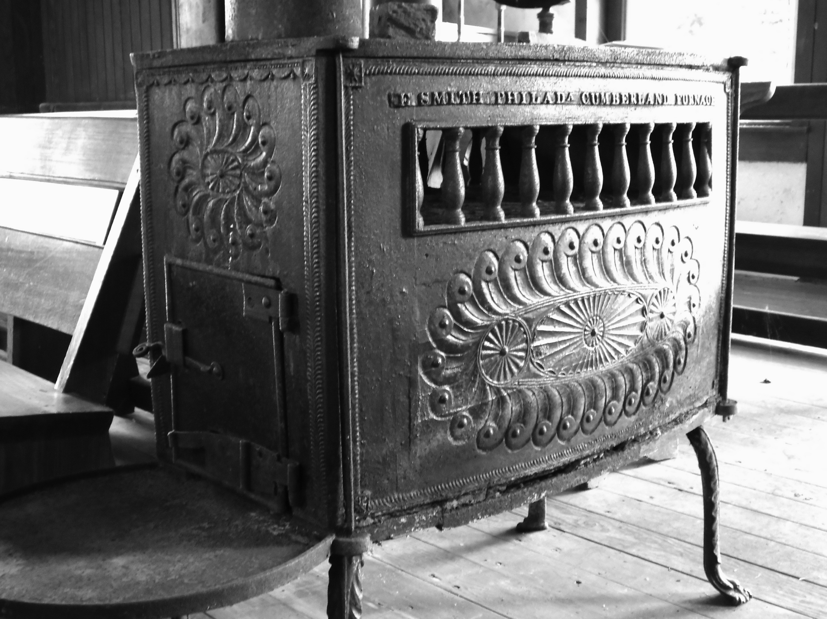
Photo by Mike Ayars

Slide 26
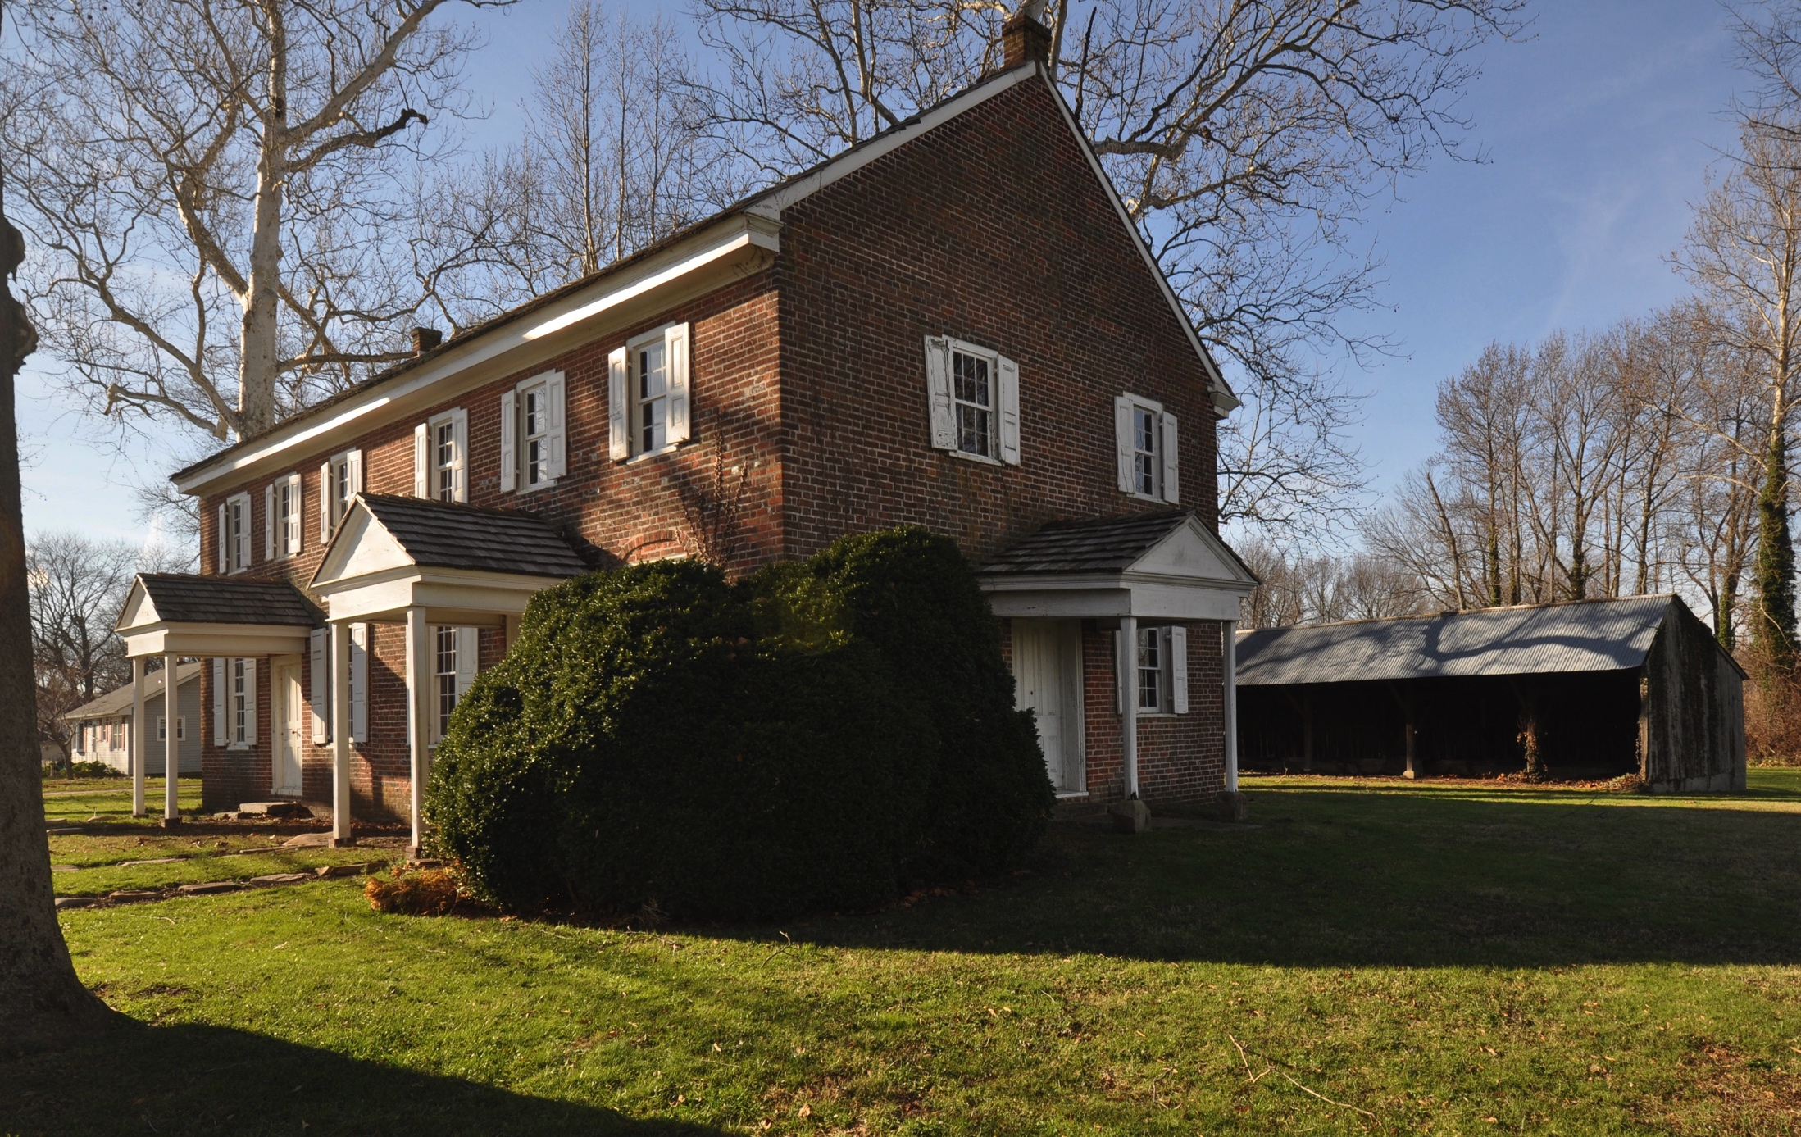
LAC meetinghouse today
Photo by Mike Ayars

Slide 27
What’s Next?
Preservation and use
Next Steps

Slide 28
Uses Workshops
Active Quaker Uses
Historic destination events
Partner with Hancock House and other associations

Slide 29
Uses Workshops
Concerns to address
Building fragility
ADA Accessibility and other code requirements
Potential needs
Lighting, heat, restrooms, water
“Friends of the LAC Meetinghouse” group

Slide 30
Current Preservation Efforts
Request for proposal: Preservation Plan
Historical Significance
Existing Conditions and Code requirements
Assessment by Structural Engineer
Mortar testing and analysis
Preservation recommendations
Preliminary Cost Estimate
Archaeologists assessment (if ADA access is required)
Documenting our work and building a knowledge base for meetings to use

Slide 31
Connections to Salem Quarter Monthly Meetings
The descendants of the early Alloways Creek Quakers are found in every monthly meeting in Salem Quarter. It’s our heritage and our genealogy.
“…a remarkable appeal to those who acknowledge the debt of the present to the past and recognize the obligation to future generations.”
From the Bridgeton Evening News, June 25, 1941
“Let’s not continue to consign it to the category of unused meetinghouse with no resident meeting. Let’s do some brainstorming about its possibilities. I am fascinated by the thought that, as we share ideas with other PYM meetings on ways or reaching out to our own members and attenders, and as we extend a welcome to others who wish to be a part of the family of Friends, more and exciting uses for Hancock’s Bridge Meetinghouse will be conceived.” - Judy Suplee, Mullica Hill Meeting, 1985
Notes:
Who do you know on these lists of names?

Slide 32
Fundraising Plans
Capital Campaign including grant applications
Repay the loan from the LAC fund at Fiduciary
Identify and prioritize the work needed to stabilize and preserve.
Solicit funds for commemorative stones in the Memory walk in memory of recent Quakers
Notes:
For example, Bill Waddington, especially more women.

Slide 33
Next Steps: How you can help us
Visit us
Bring your intergenerational FDS class
Attend a summer Meeting for Worship
Invite us to share this presentation with your meeting
Explore the Bayshore Heritage Scenic Trail by car or bike <photo of trail marker needed>

Slide 34
Members of the 1756 Alloways Creek Meetinghouse Committee
Mike Ayars Woodstown Clerk/Convener
Dave Cadwallader Salem
Christine Cameron Salem
Preston Carpenter Salem
Dave Culver Salem Clerk emeritus
Ron Magill Salem Old House Foundation
Keith Ragone Woodstown
Paul Somers Greenwich
Jared Valdez Mickleton
Jim Waddington Salem
Mary Waddington Salem
Penny Watson Greenwich

Slide 35
Questions?

Slide 36
More information
Mike Ayars 856-478-4618 mike.ayars@gmail.com
Meetinghouse is at
74 Buttonwood Avenue, Hancock’s Bridge
(Lower Alloways Creek).

